Slide 1
Automatic Detection and Segmentation of Brain Tumor Using Random Forest Approach
Bachelor Seminar WS 2020/21
“Medical Image Computing and e-Health”
08.01.2020
Prof. Dr. Heinz Handels, Prof. Dr. Josef Ingenerf, Prof. Dr.-Ing. Marcin Grzegorzek and coworkers
Institute of Medical Informatics
Universität zu Lübeck

Slide 2
Outline
Motivation
Basics
Binary Decision Trees (BDT)
Random Forest (RDF)
Methods
Application in Paper
Results of the Experiment
Conclusion

Slide 3
Motivation
Author: Zoltán Kapás, Release: 2016
Building reliable procedure for tumor detection
Based on supervised machine learning
Primary Goal: Early Detection
Secondary Goal: Segmentation
Currently challenging due to variety of anatomical structures

Slide 4
Basics

Slide 5
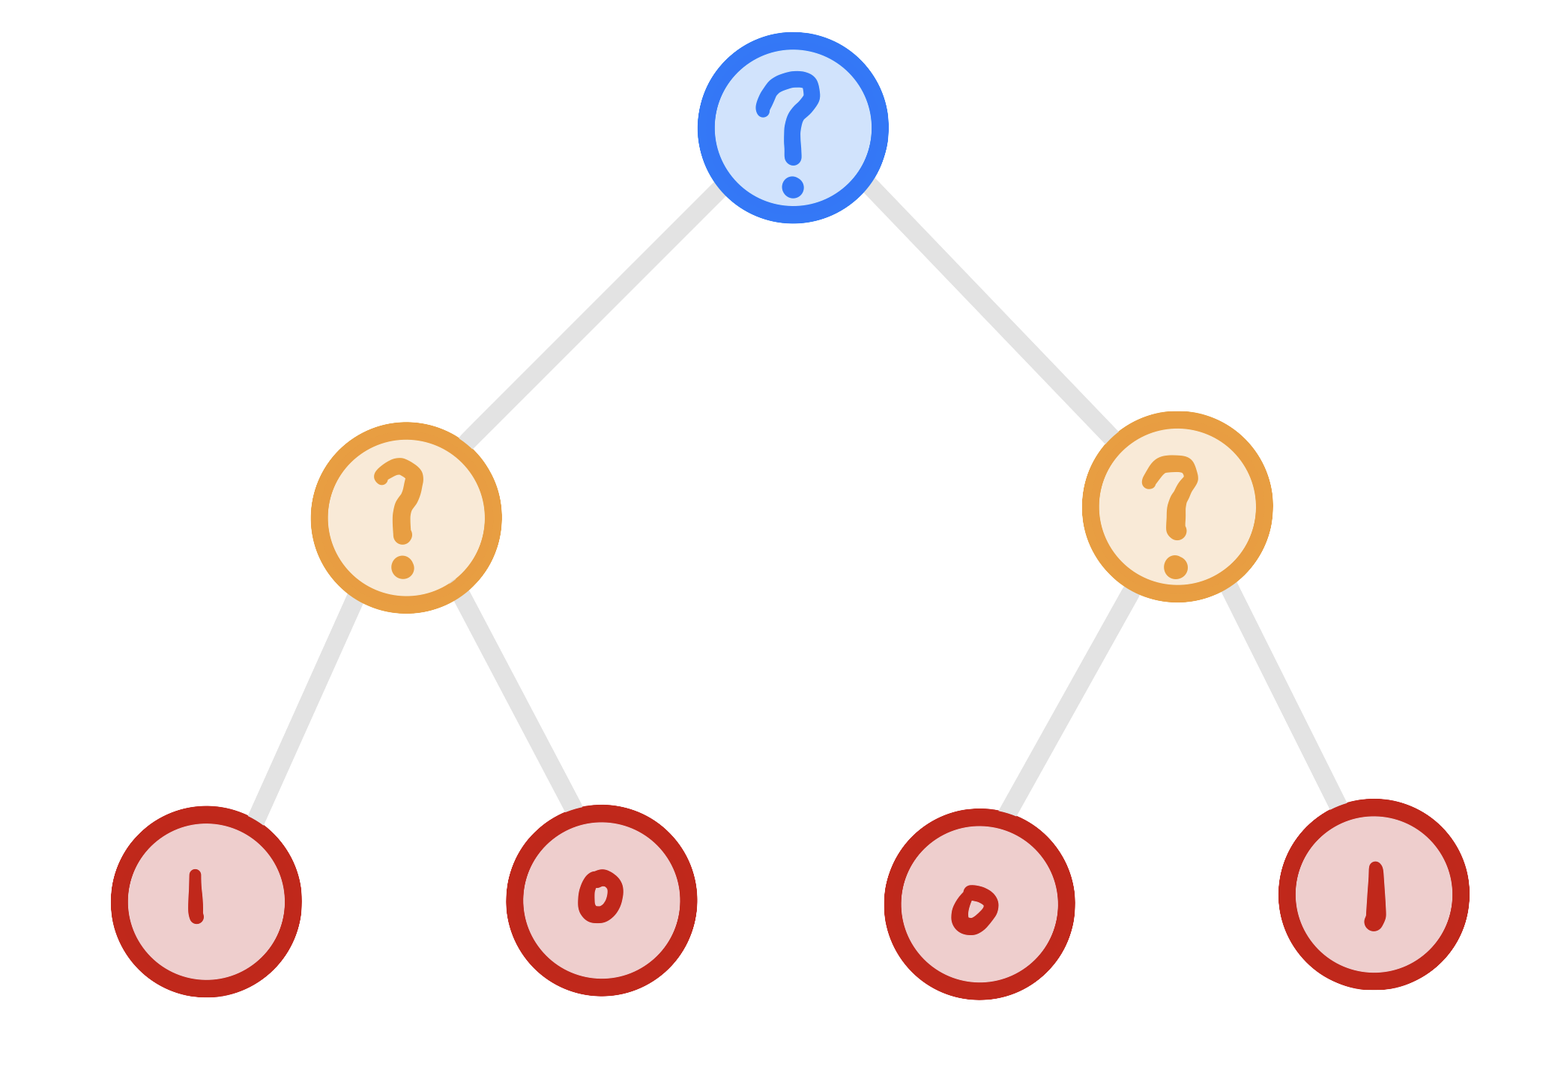
Basics - BINARY DECISION TREE
Hierarchy of two-way decisions
Learn Classification of training set
Decision at leaf node
ROOT
SPLIT
LEAF

Slide 6
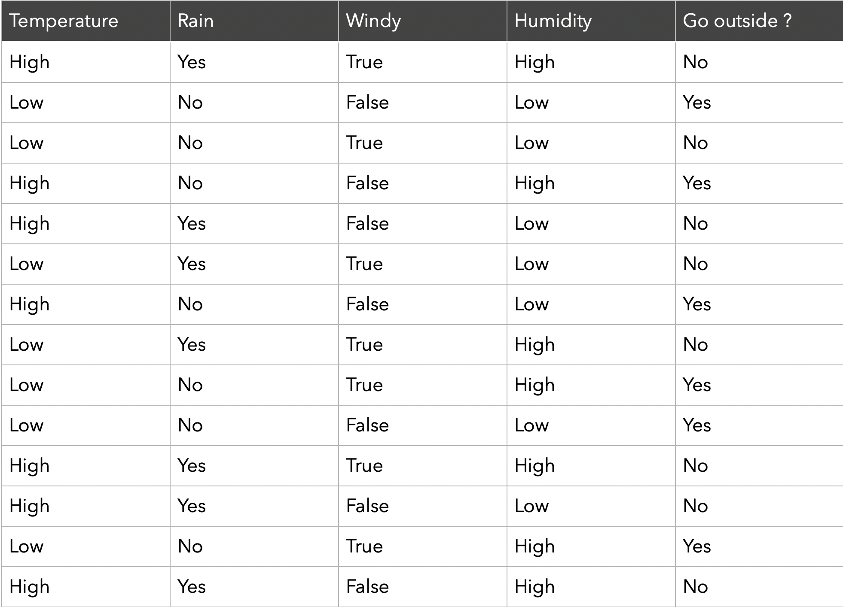
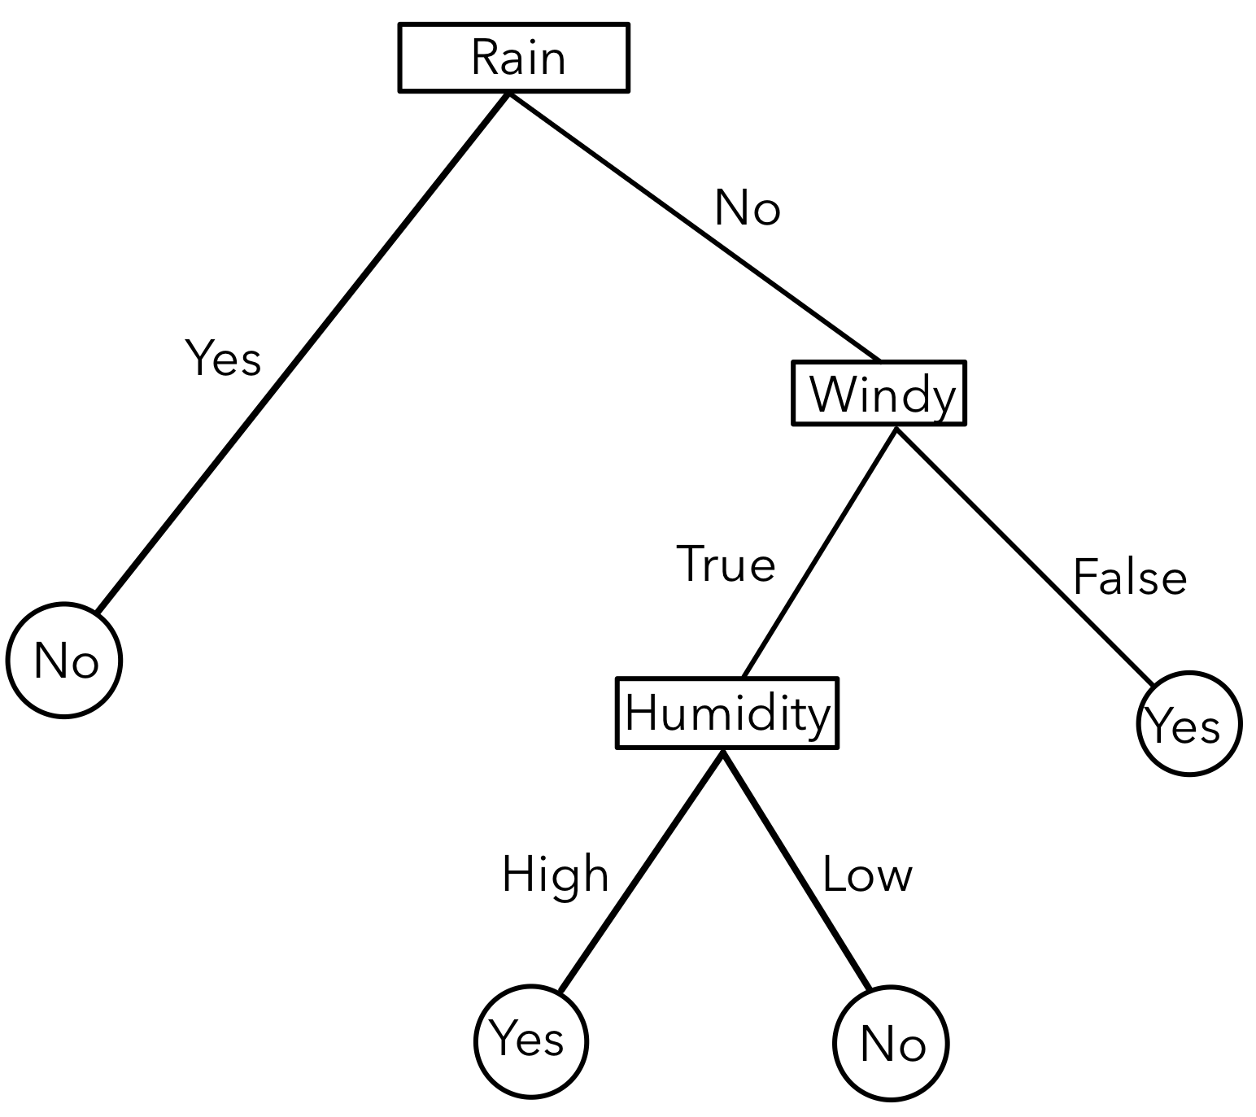
Basics - BINARY DECISION TREE

Slide 7
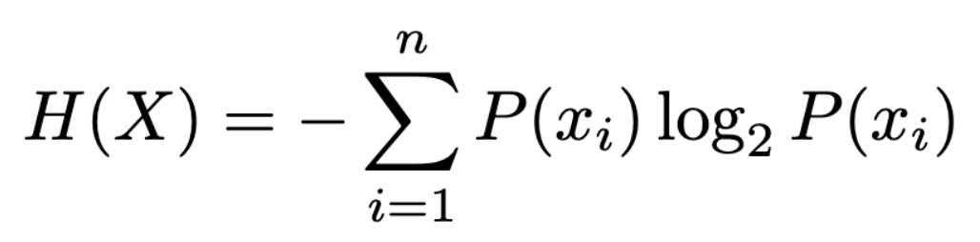
Building a BDT
Pick feature with most efficient division
Entropy → Information Gain
Test every feature
Leaf node if subset is indistinguishable

Slide 8
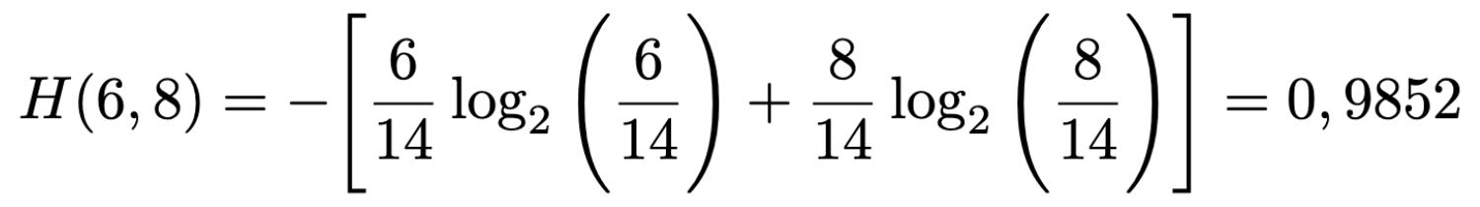
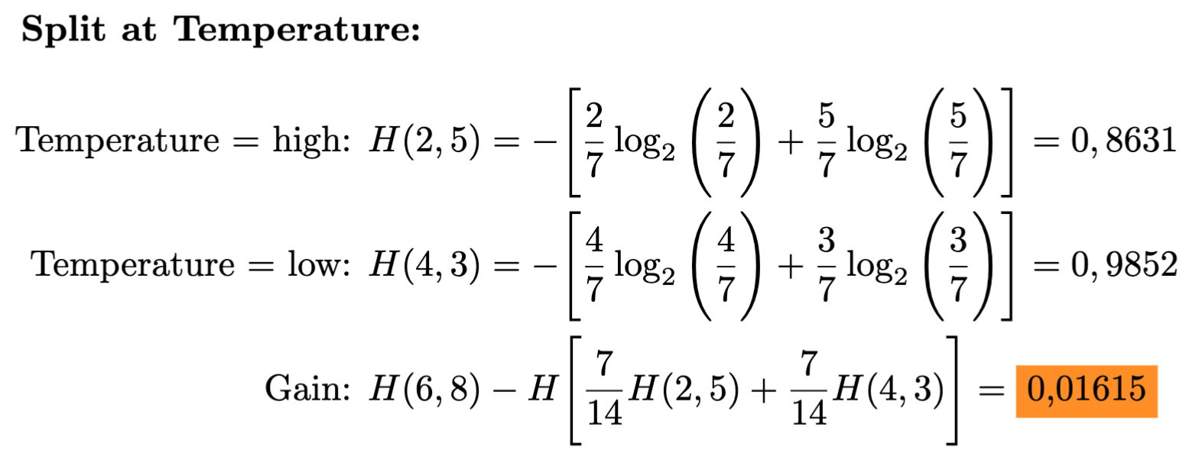
Information Gain

Slide 9
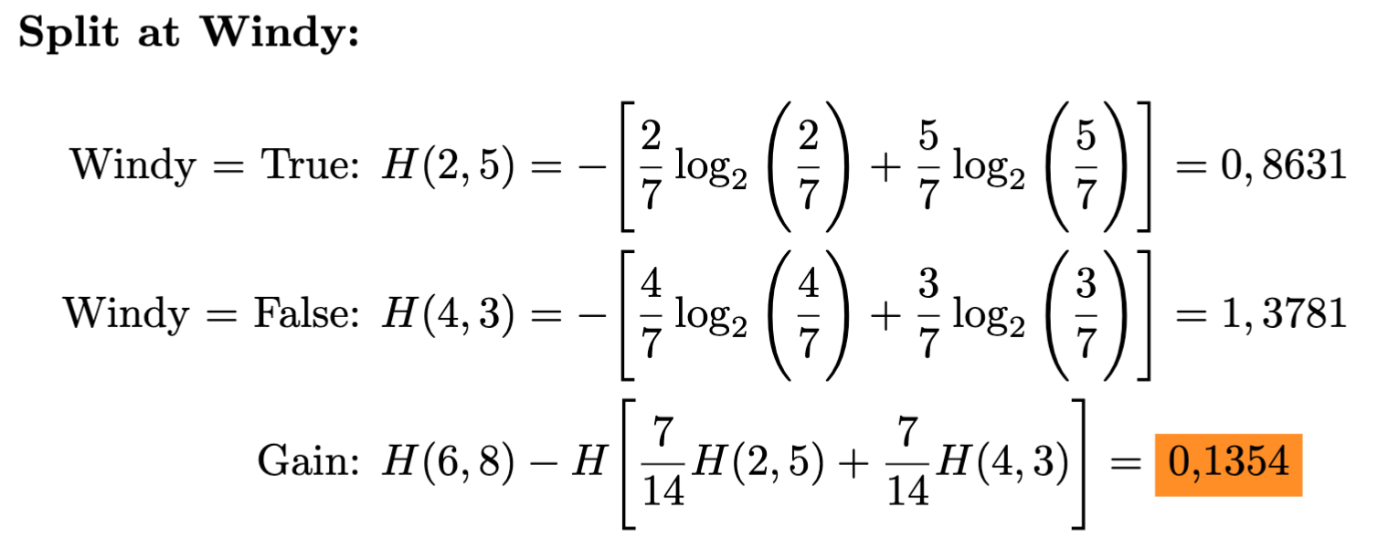
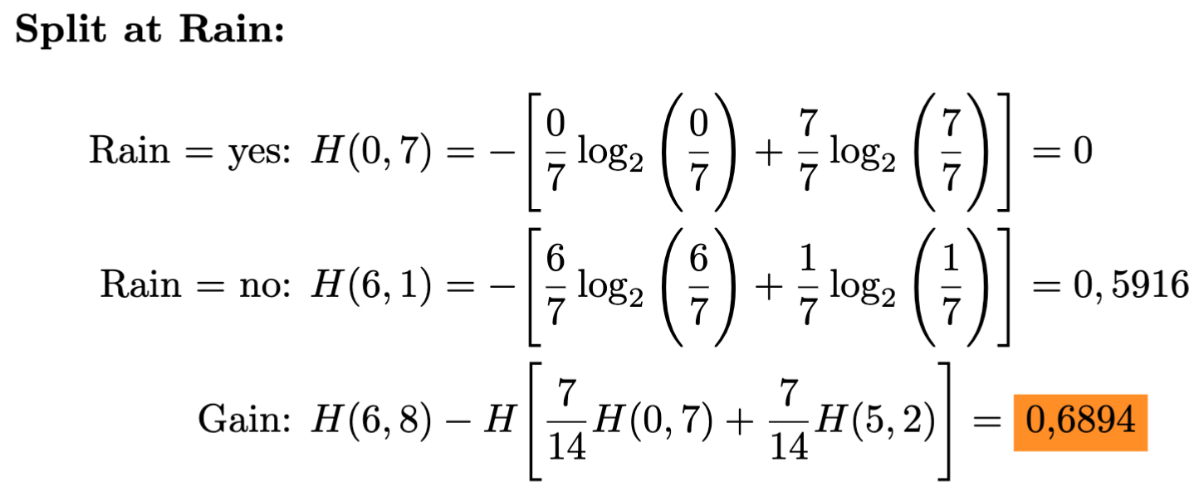
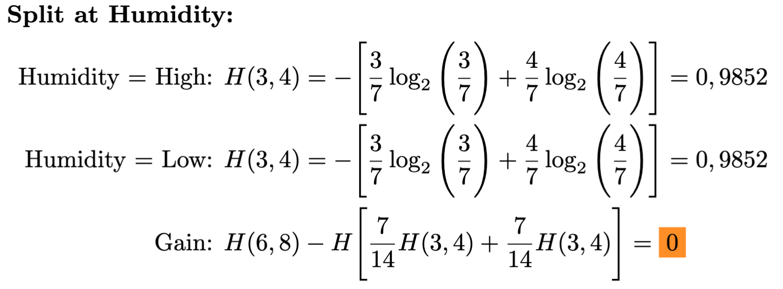
Information Gain

Slide 10
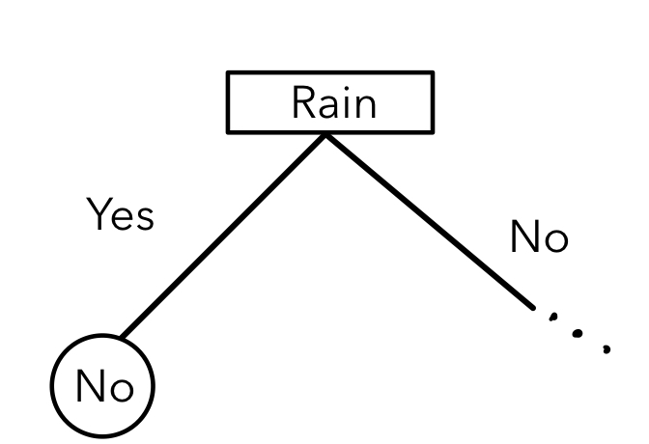
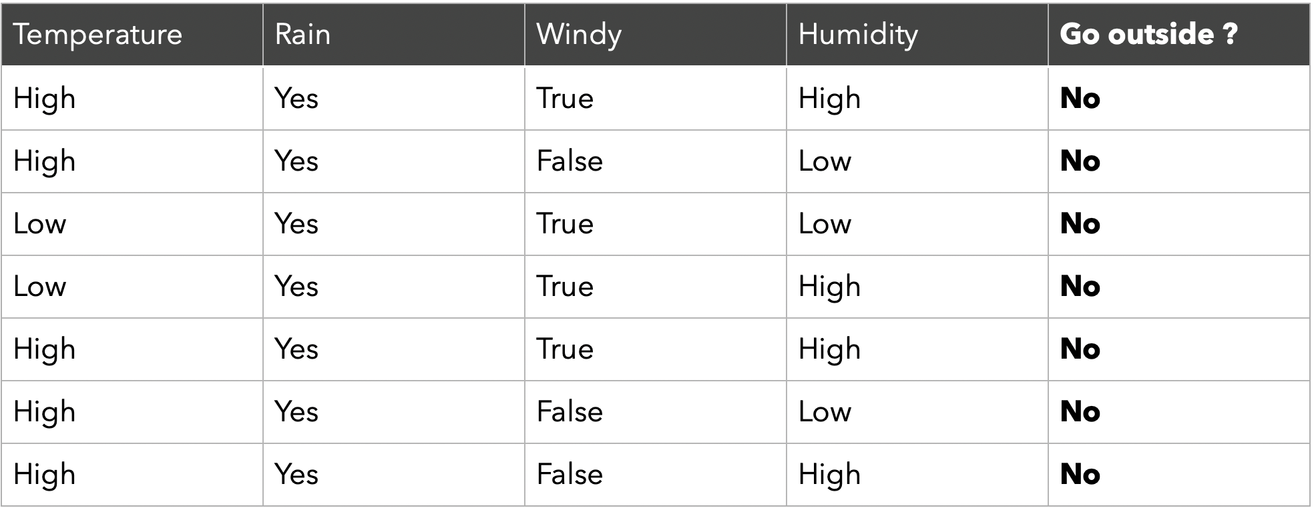
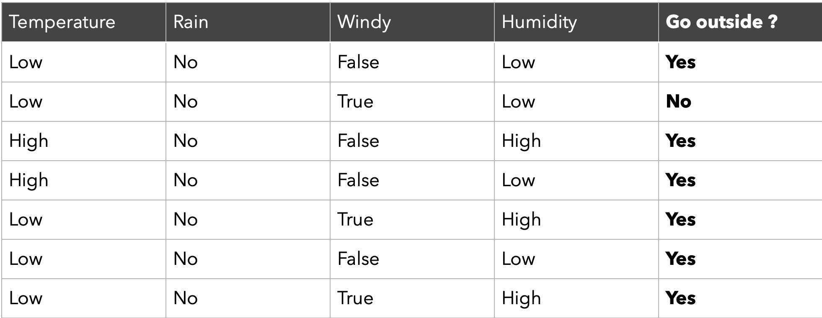
Split subsets

Slide 11
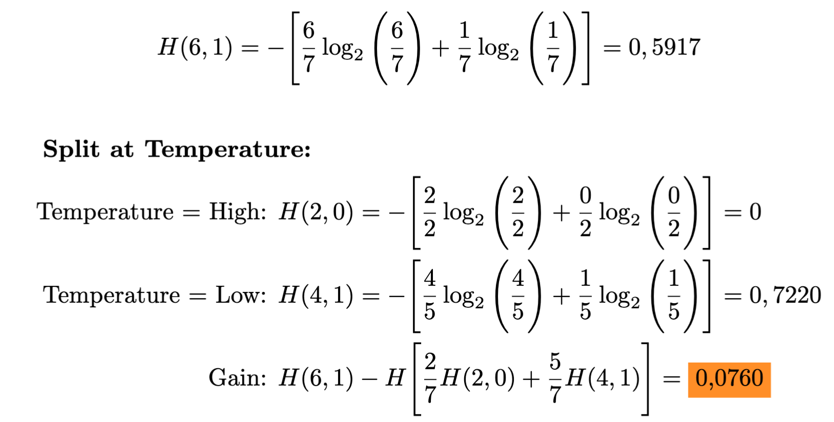
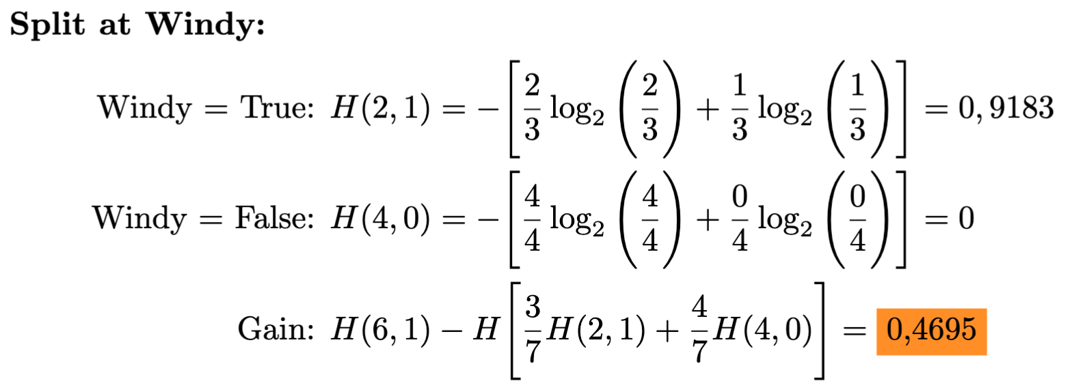
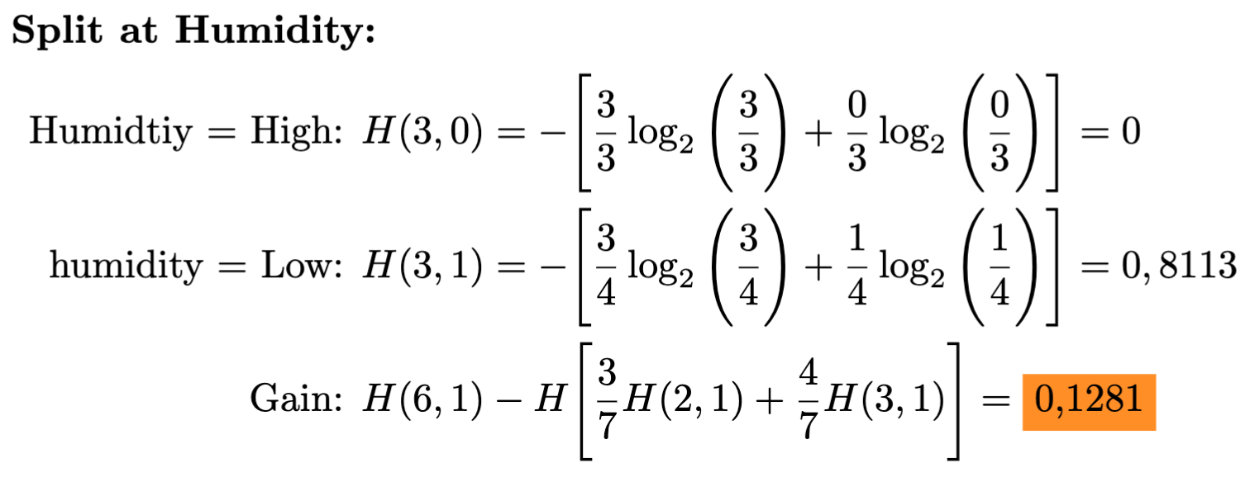
Split subsets

Slide 12
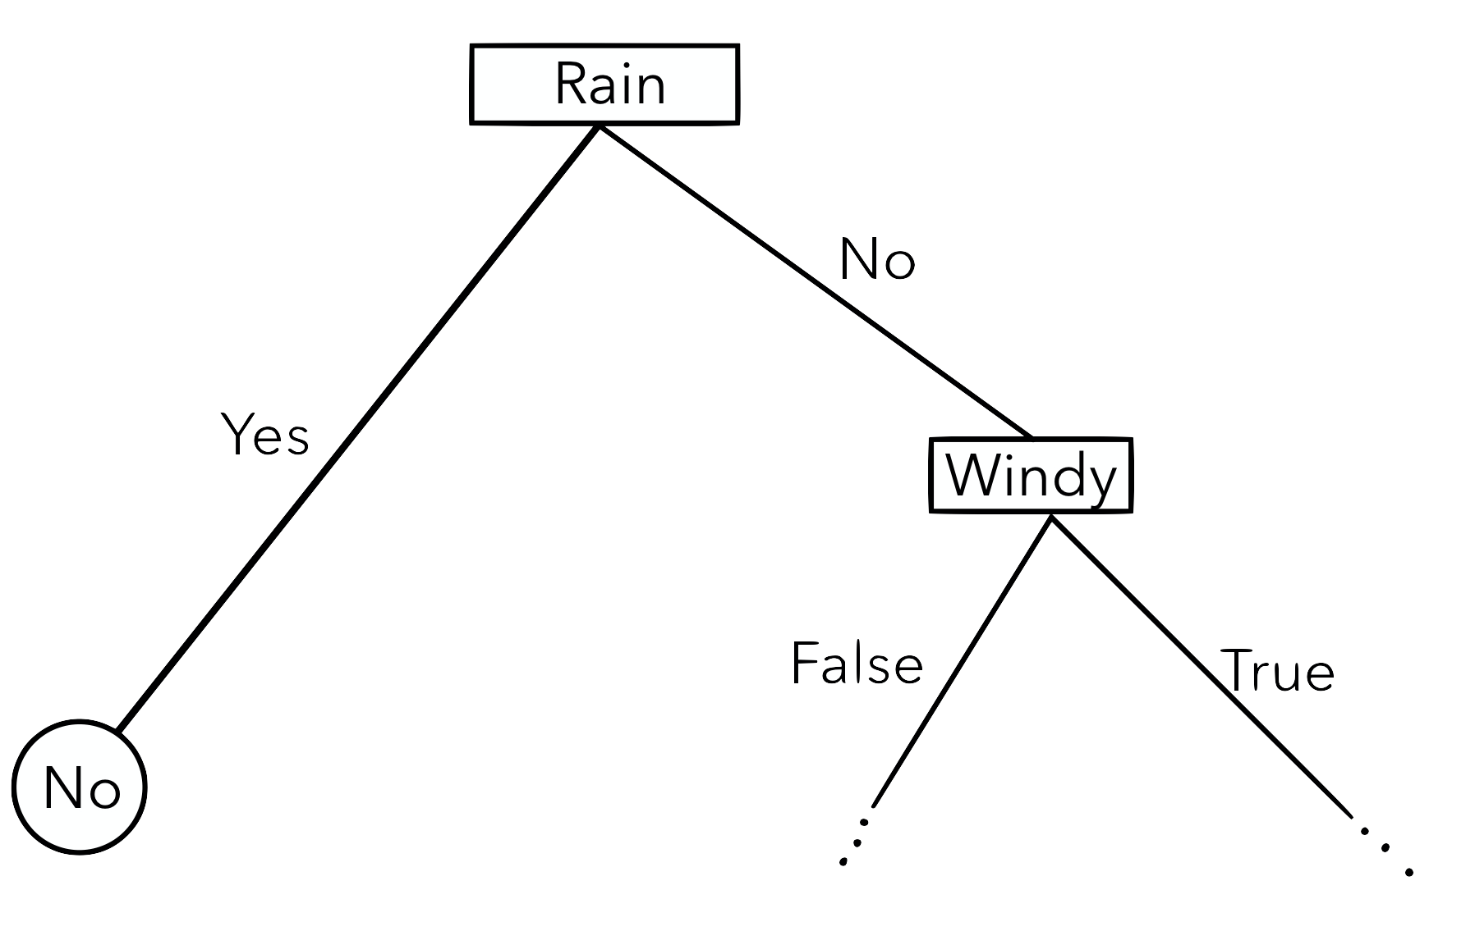
Split subsets

Slide 13
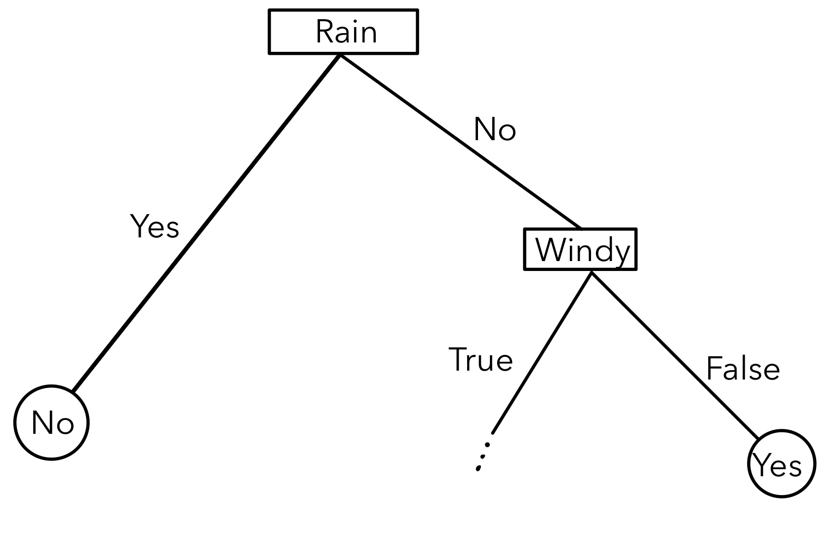
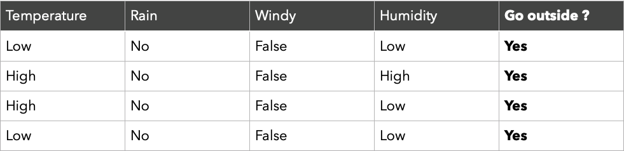
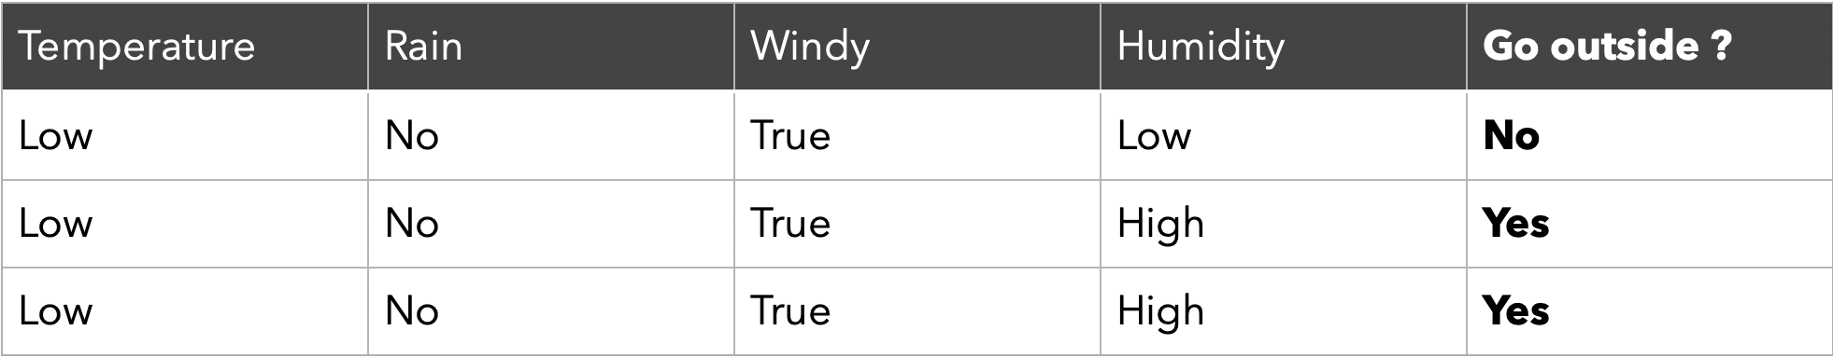
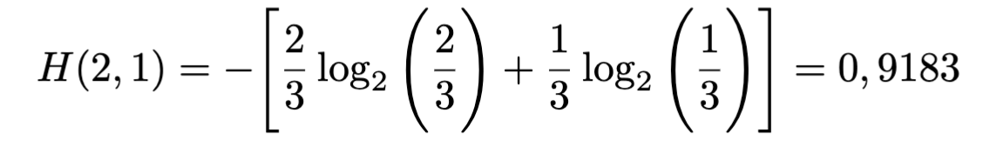
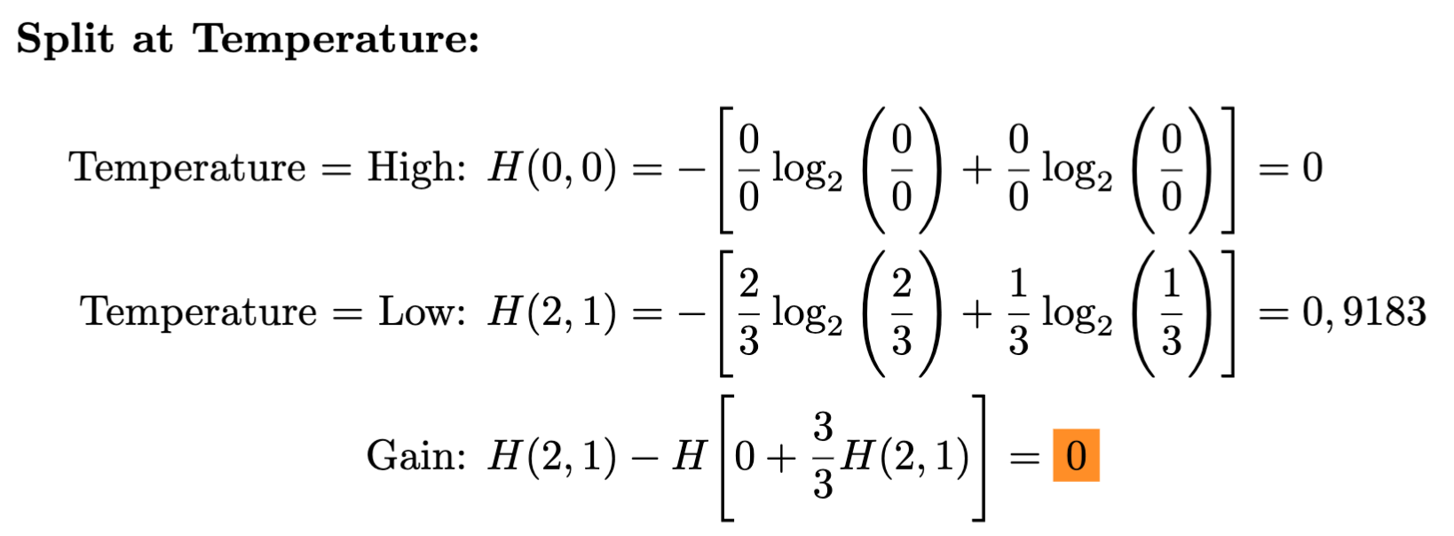
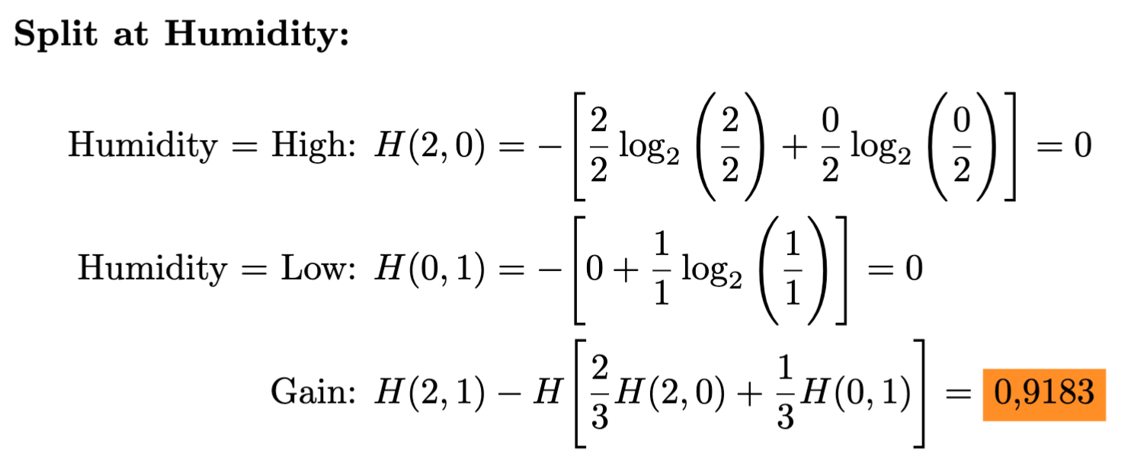
Split subsets – NO RAIN

Slide 14
Final BDT

Slide 15
Testing BDTs
Not all data is used for training
Choose samples from remaining data
Compare yielded results with true result (supervised)

Slide 16
BDT ±
PRO
CON
Detect and learn patterns
Classifies training data reliably
…
Overfitting
….

Slide 17
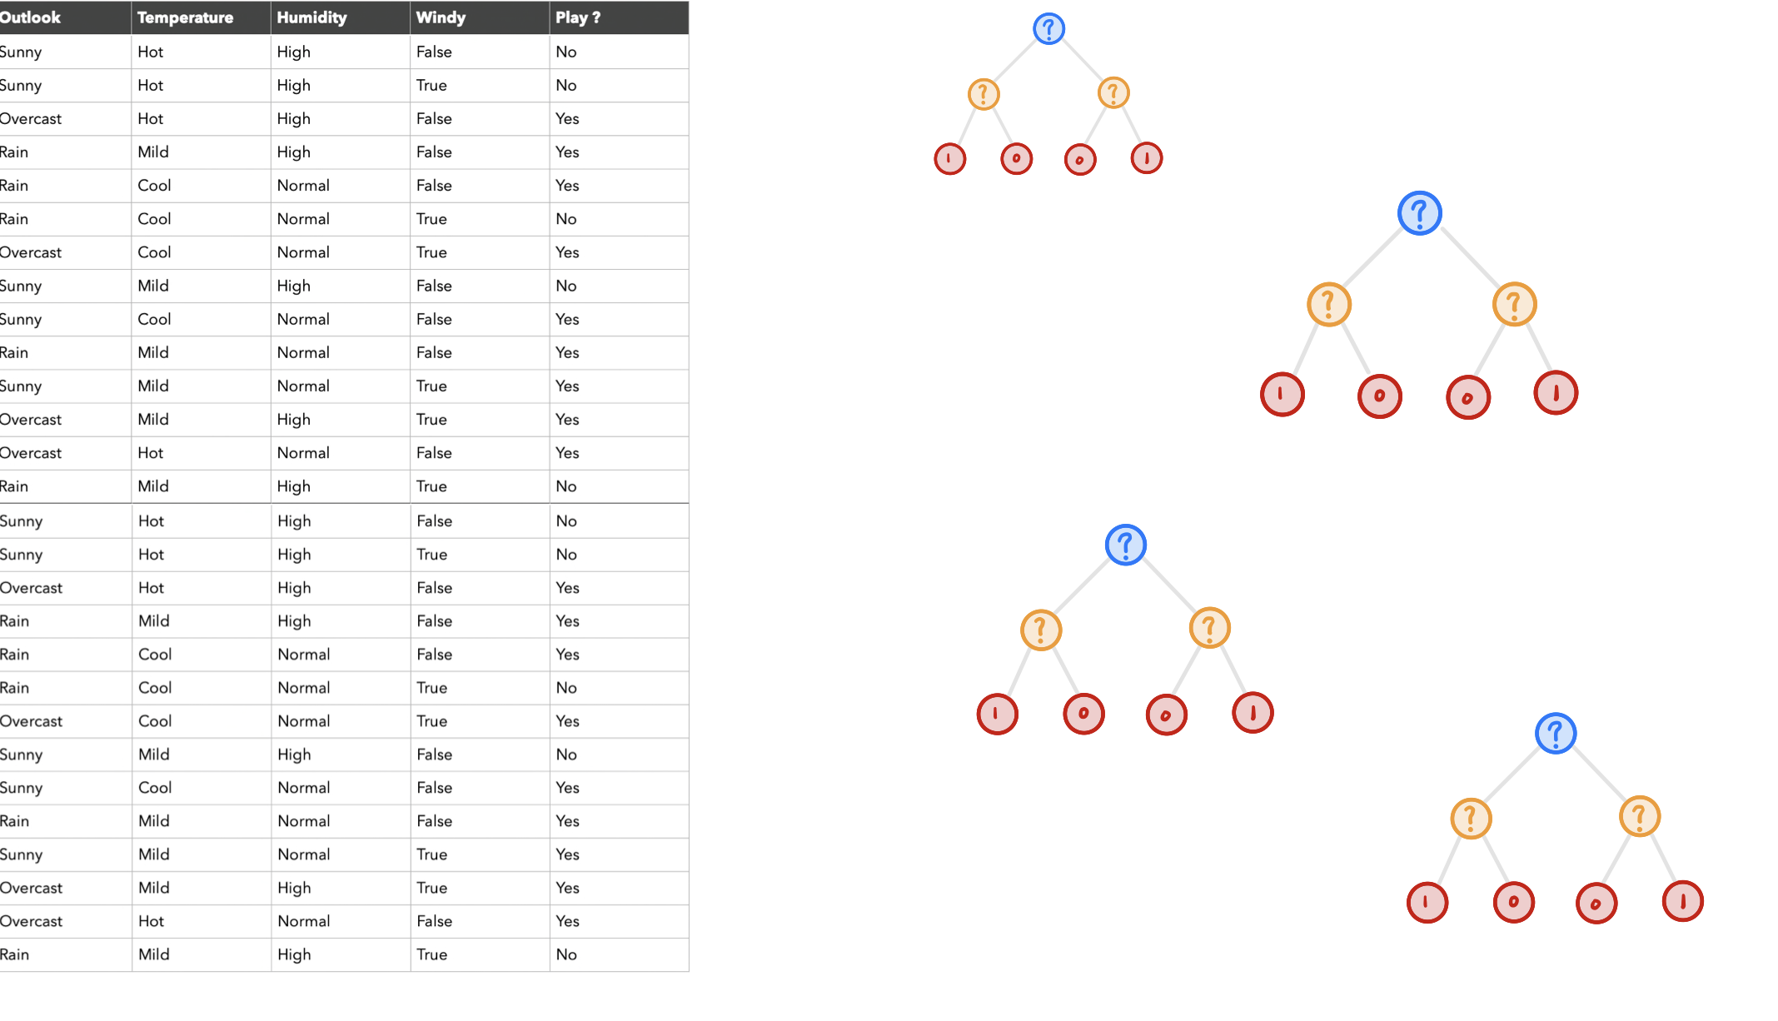
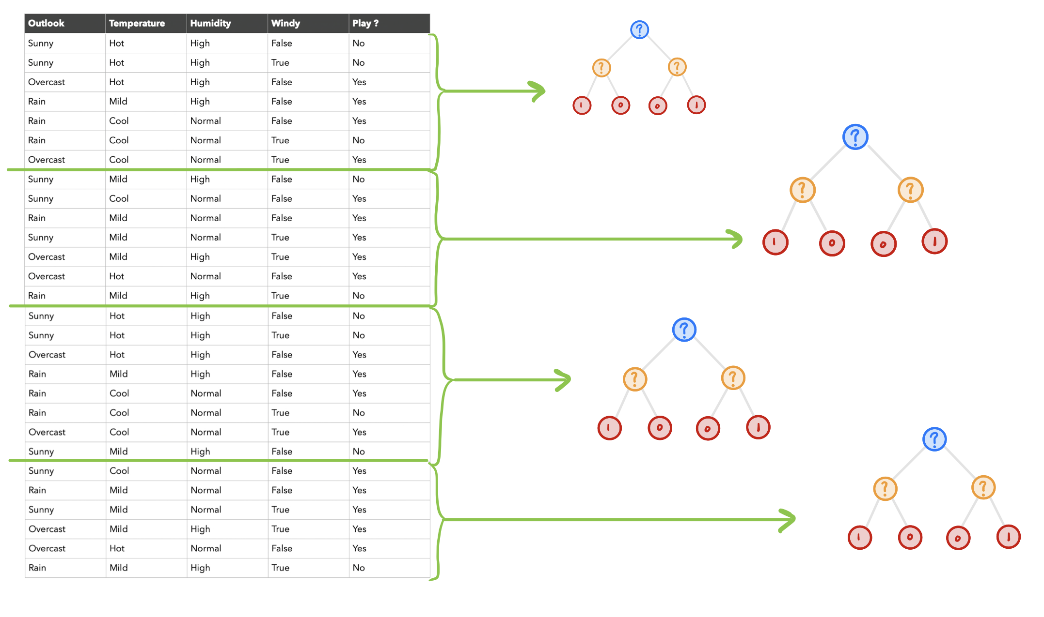
Random Forest
Combination of multiple BDTs
Final decision through majority vote
Bagging:
Each tree is trained with individual sample of training data
Decision

Slide 18
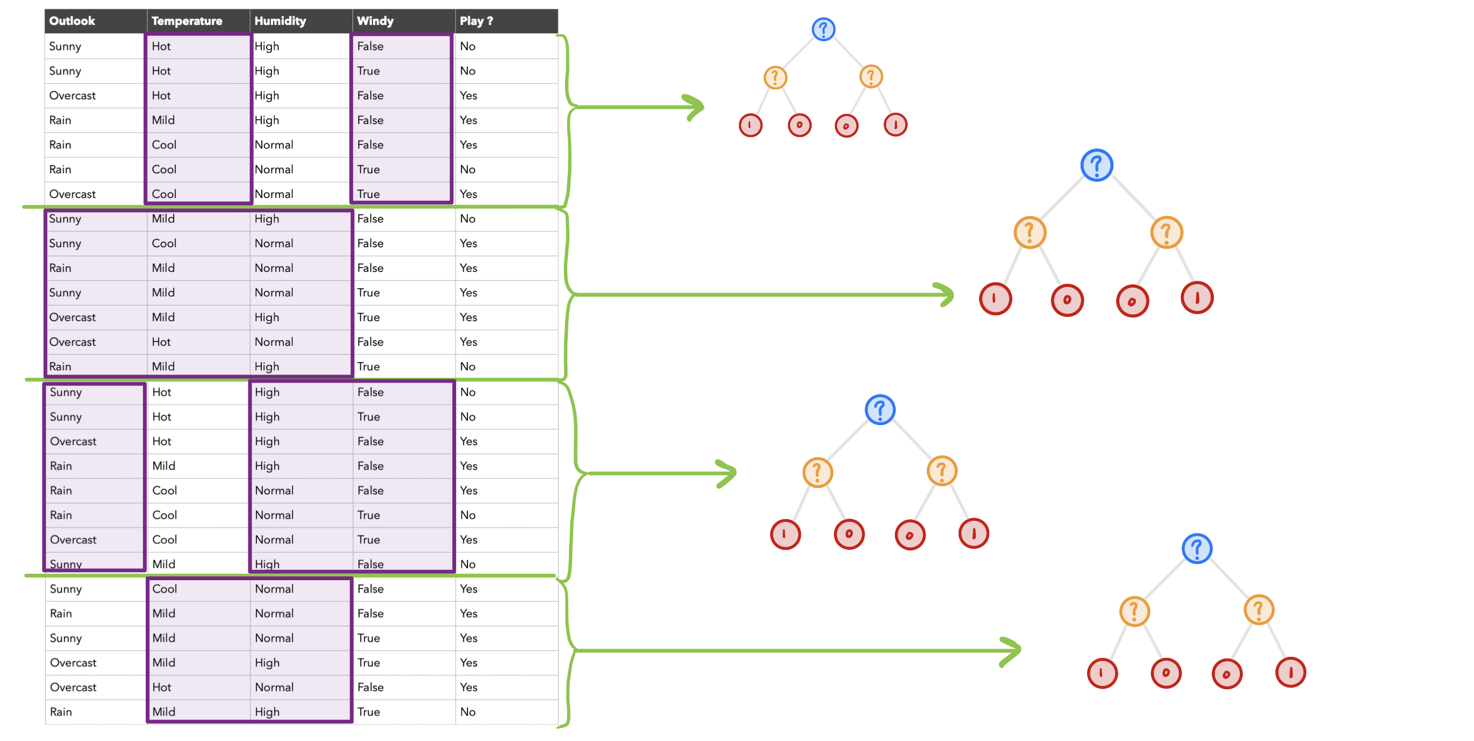
Random Forest
Bagging: Every sample uses all features
Addition RDF: Subsets of traing data use subsets of features

Slide 19
Methods

Slide 20
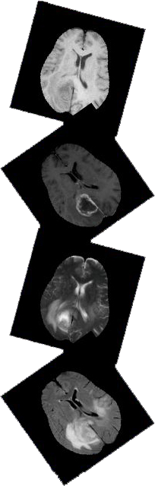
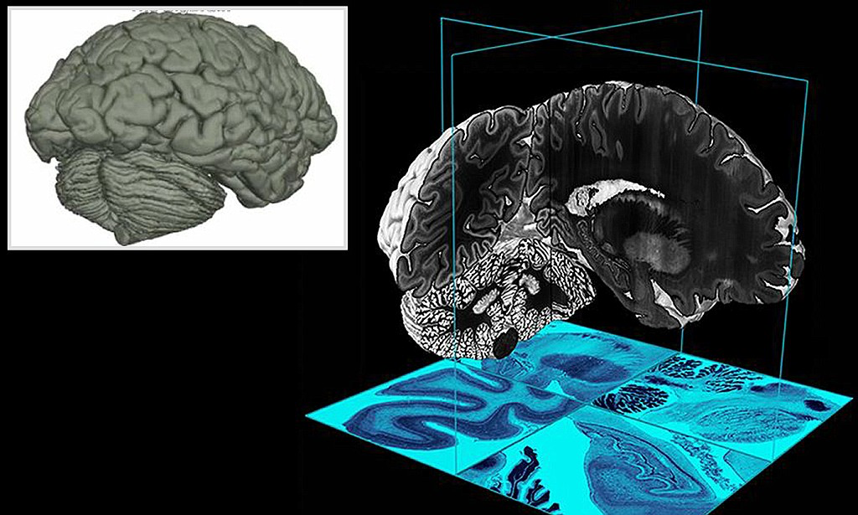
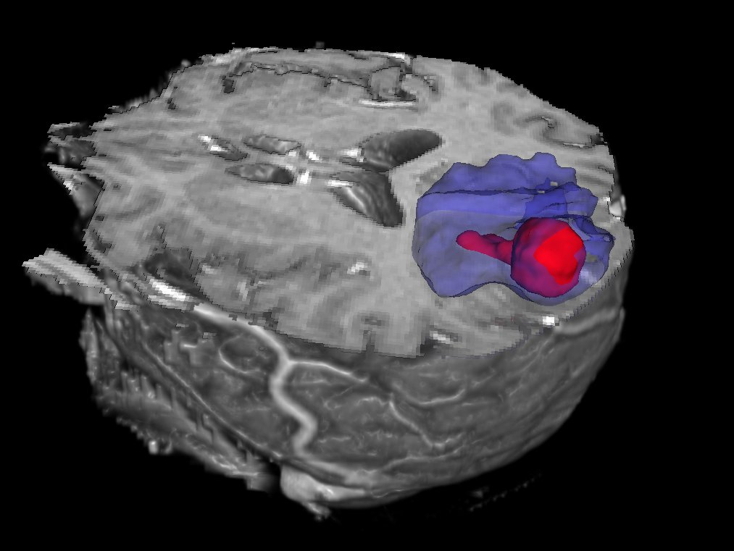
Overview
Volume: 3D-Model of a human brain
Twelve patients
Four different scans (T1, T2, T1C, FLAIR)
1.5 Mio vectors per patient
Truth-image with expert‘s connotations
Separation Tumor, Edema, Negative

Slide 21
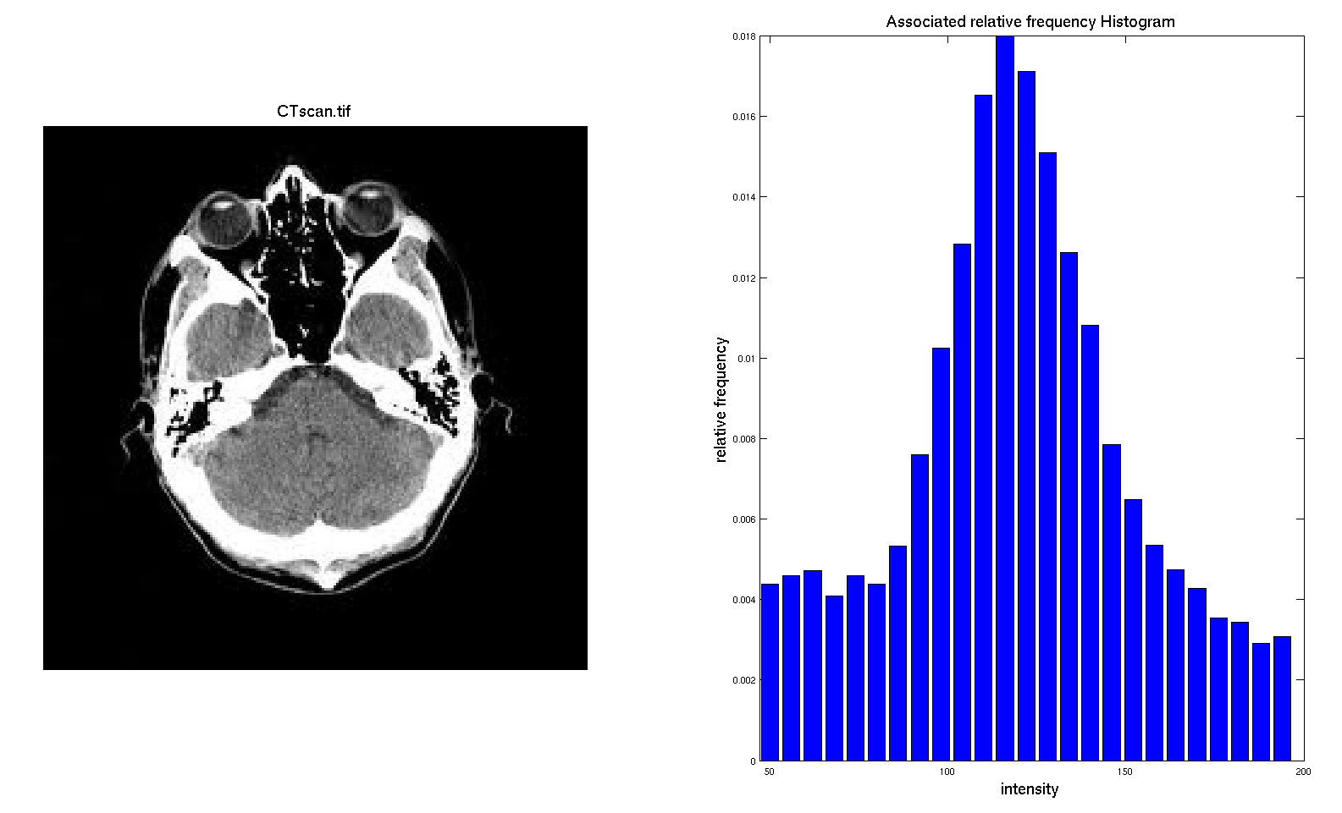
Preprocessing
Histogram Normalization
Lists intensity of each voxel
Moves middle 50% between 600 and 800
Limits 200 – 1200
Computed Features
Voxel intensity values do not carry location information
Add 8 more features (10 Elements & 26 Elements)
Missing Data
Problem: Missing pixels distort average computation of features
What exactly does the algorithm do here ?
https://www.google.com/url?sa=i&url=http%3A%2F%2Fwww.sci.utah.edu%2F~acoste%2Fuou%2FImage%2Fproject1%2FArthur_COSTE_Project_1_report.html&psig=AOvVaw0hm5pvrxmiO8zrLrqrgMxx&ust=1604956214315000&source=images&cd=vfe&ved=0CAIQjRxqFwoTCNDQy_3t8-wCFQAAAAAdAAAAABAD

Slide 22
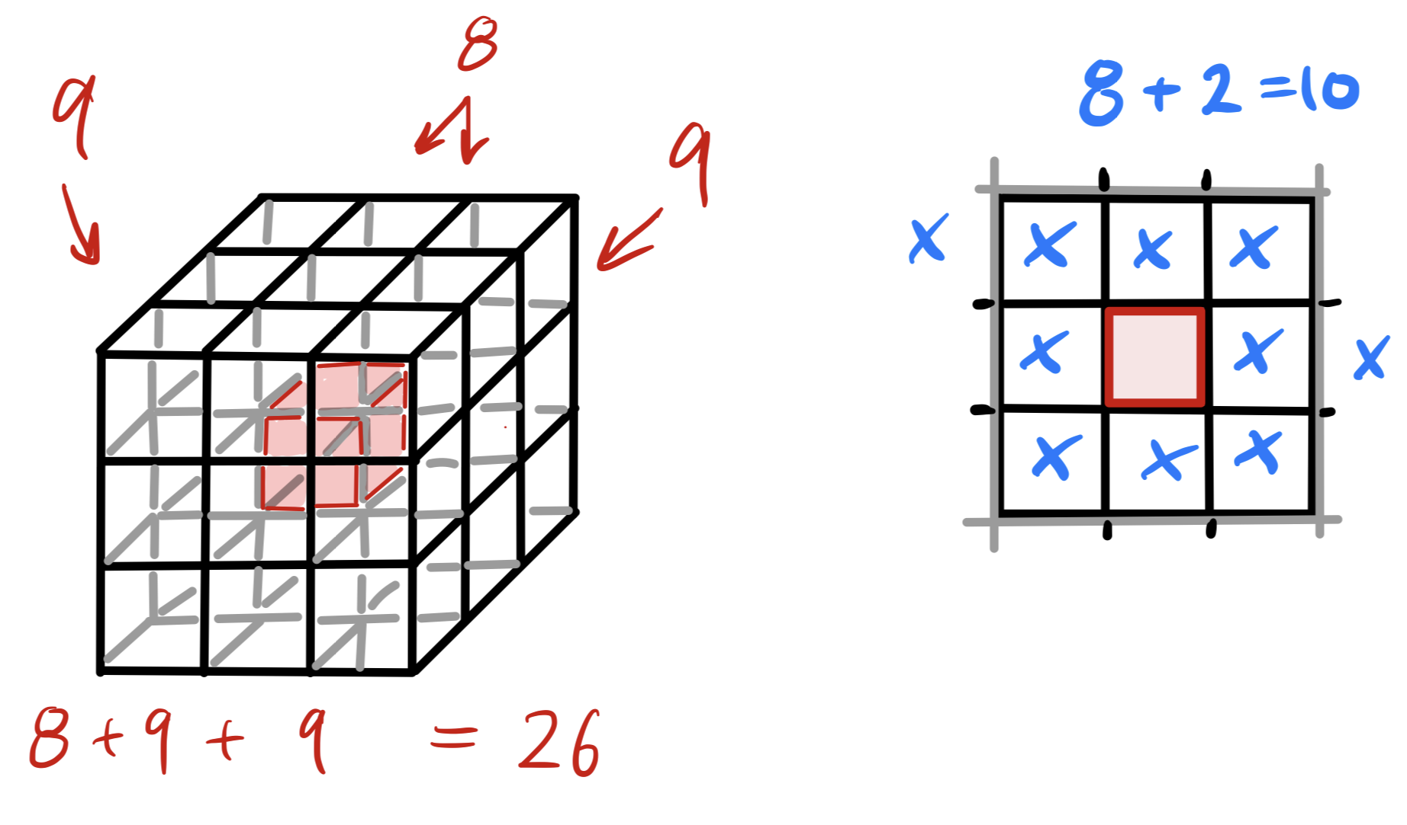

Slide 23
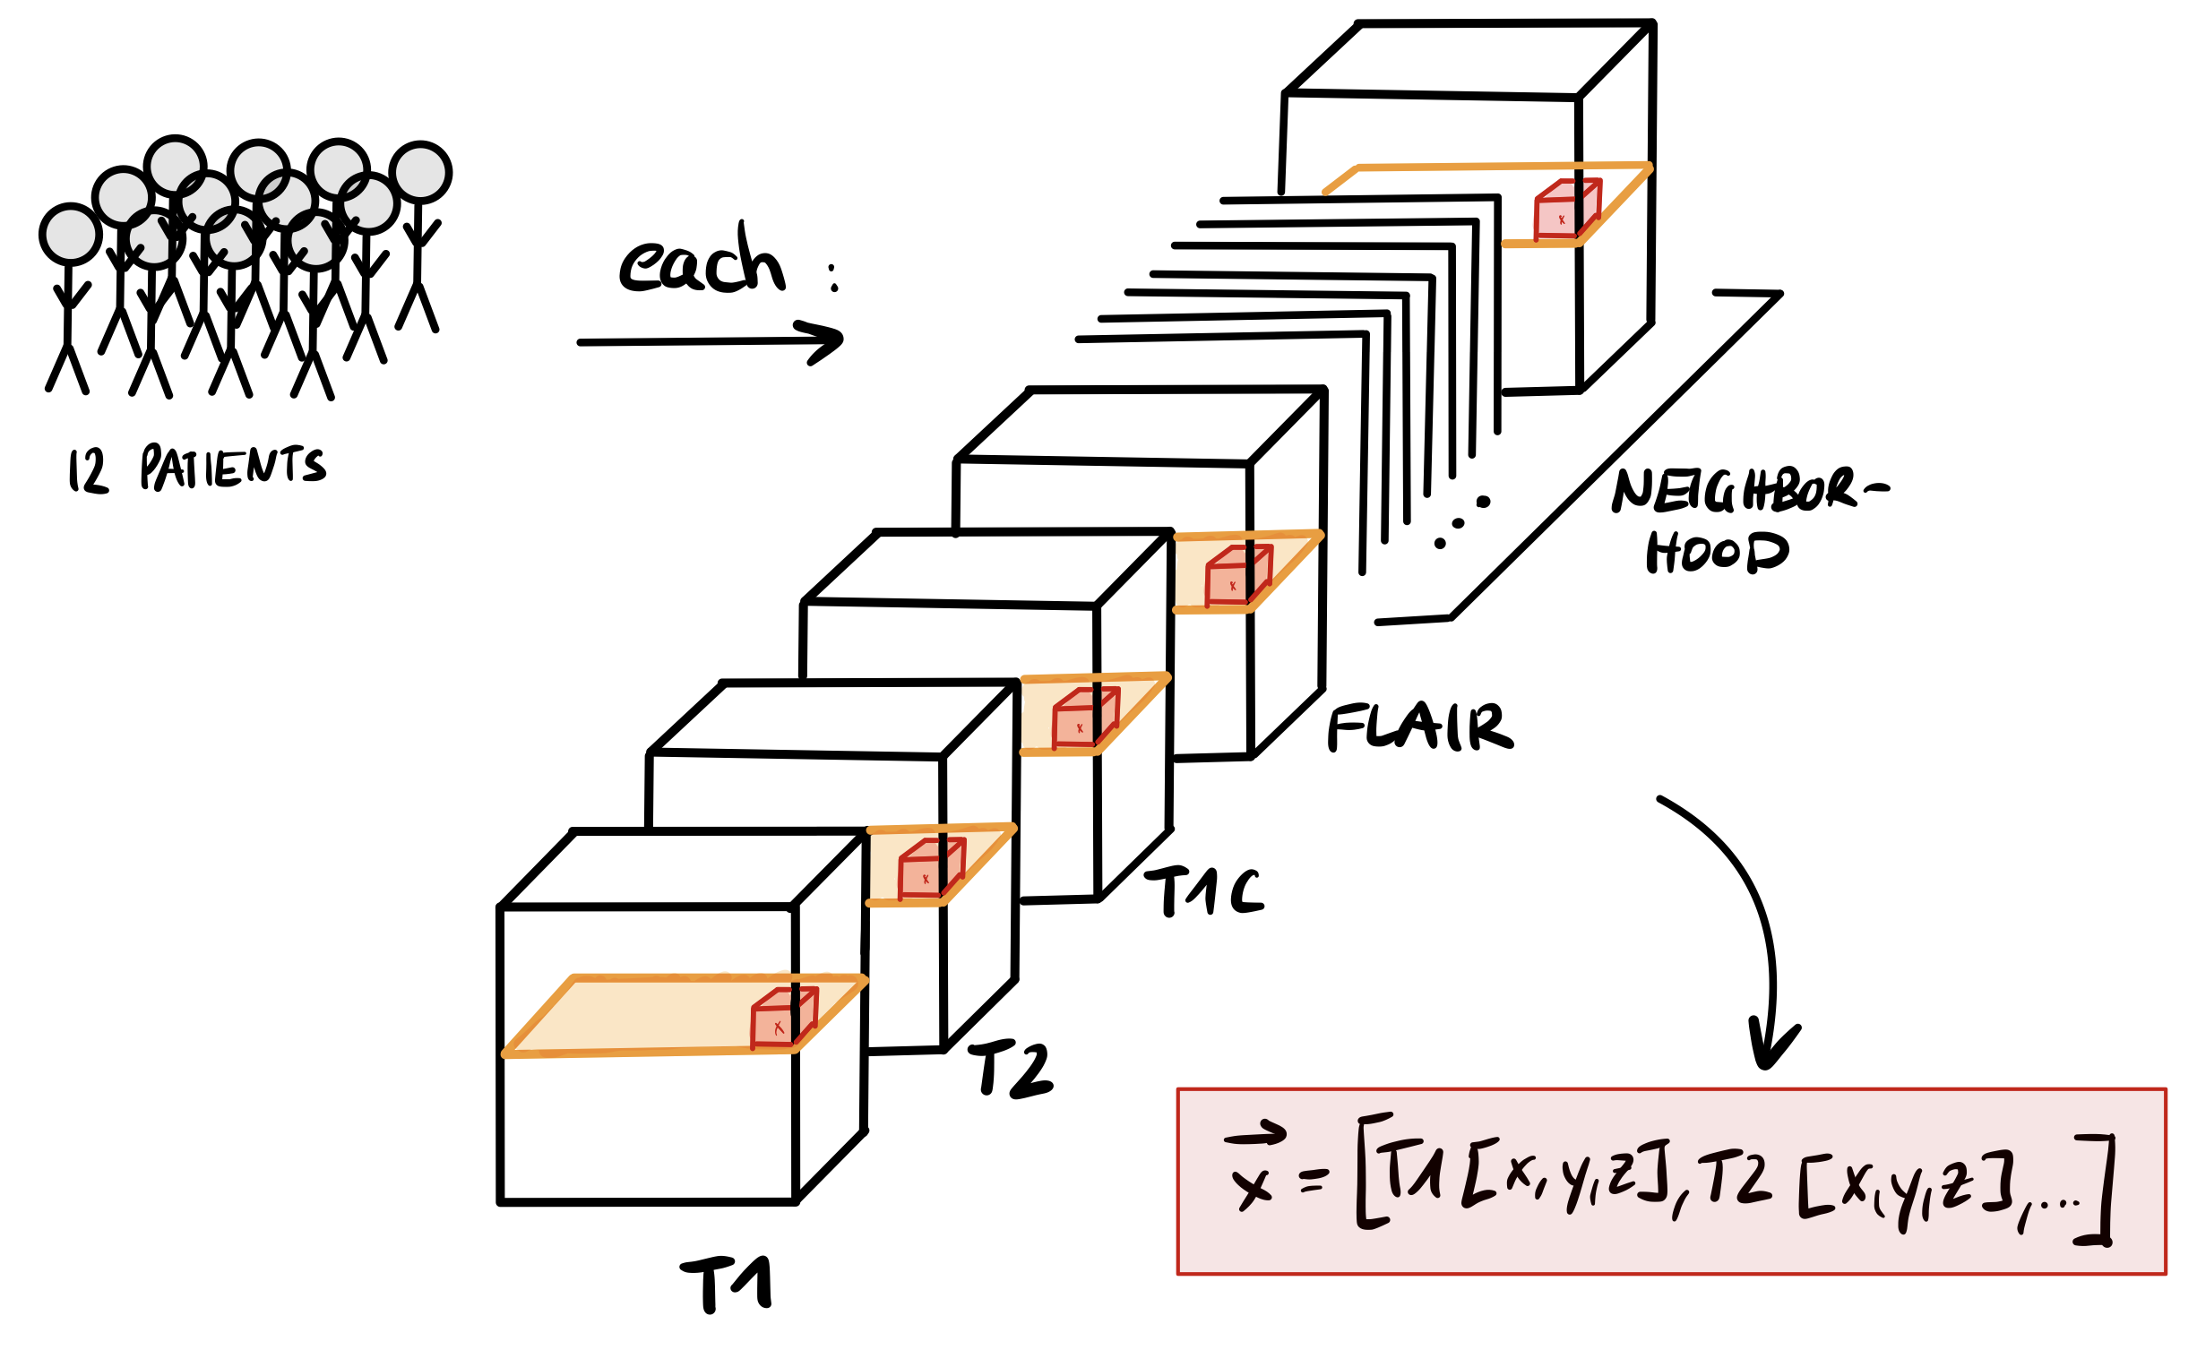
Feature Vector
Way to address a specific voxel…
… in all scans

Slide 24
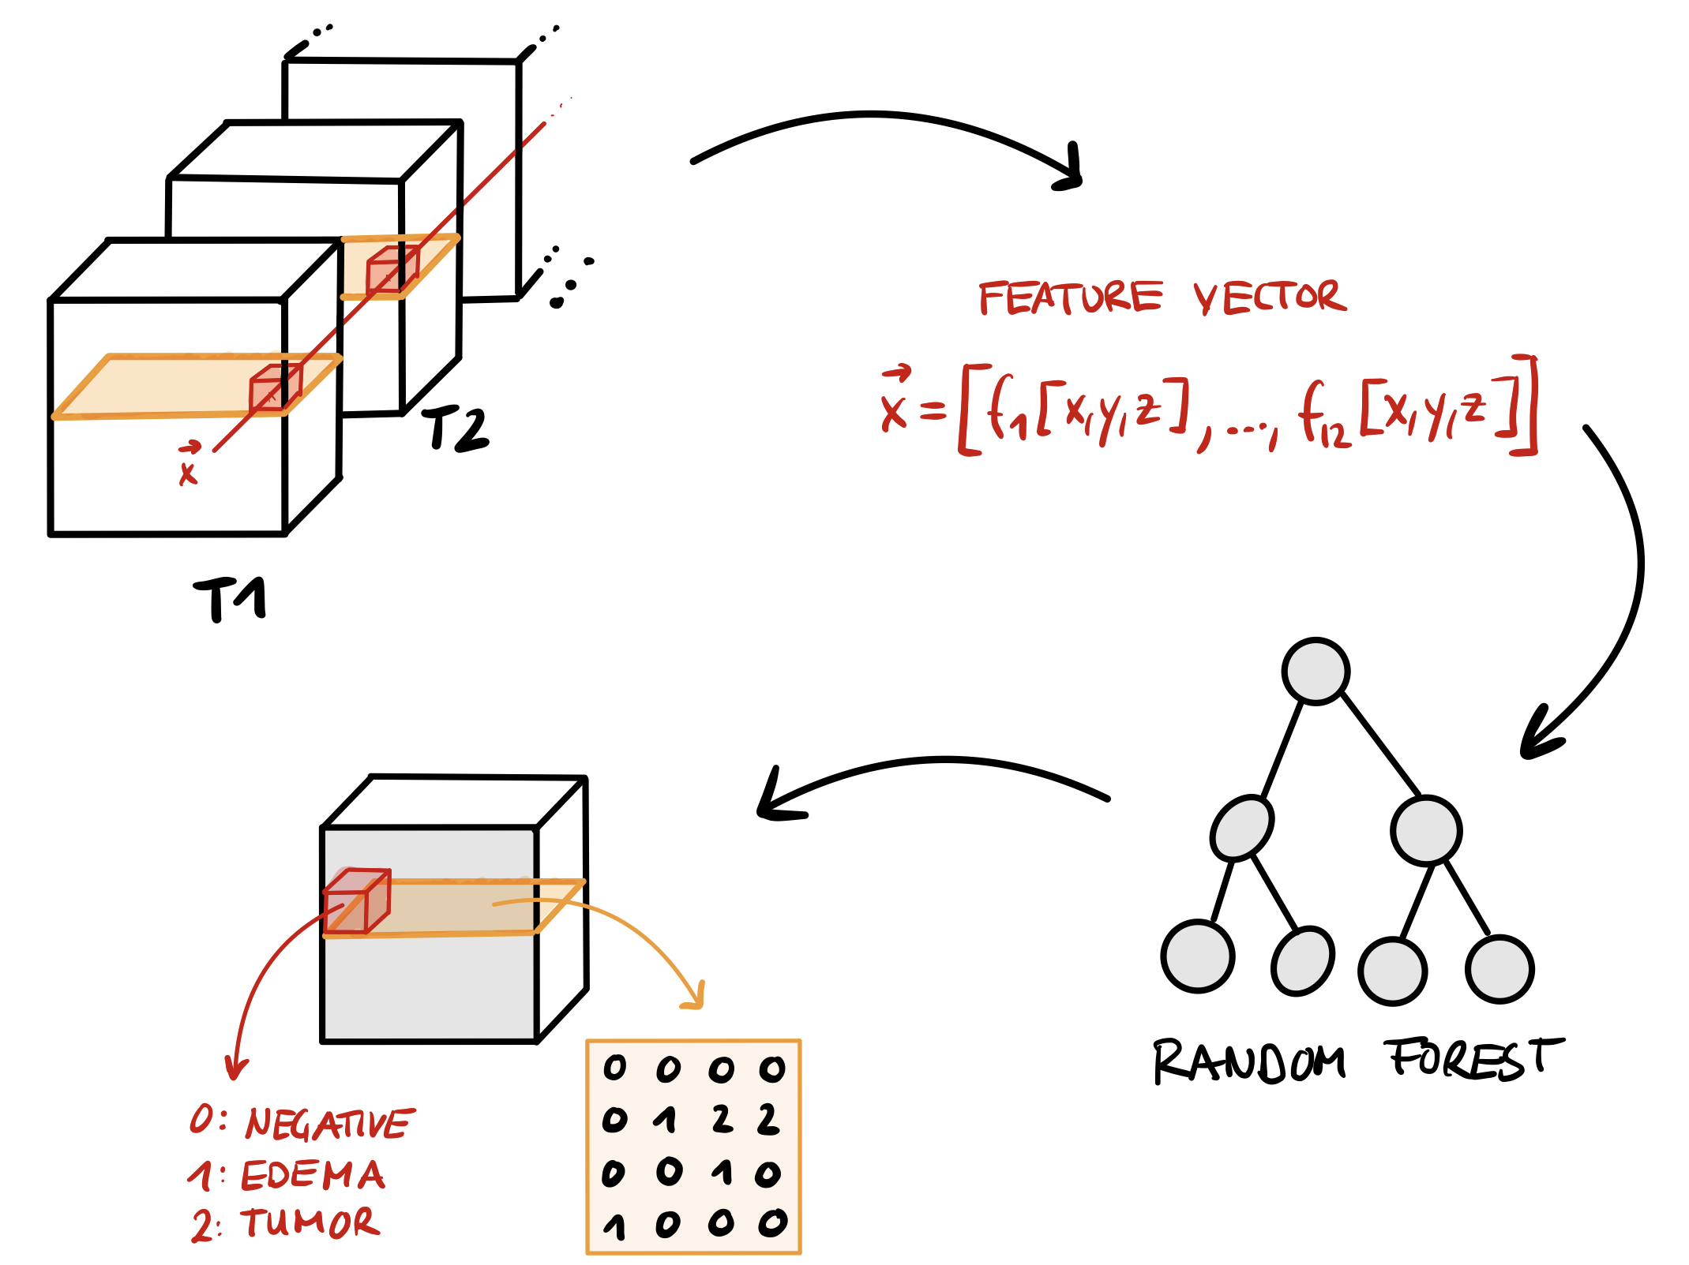
I/O

Slide 25
Post-Processing
Discover false positives
Negative voxels labled as tumor or edema
For each voxel labeld as tumor or edema:
Define 250-voxel neighborhood
Define Threshold
Count number of tumor- and edema-neighbors
If number smaller than threshold, relable as negative

Slide 26
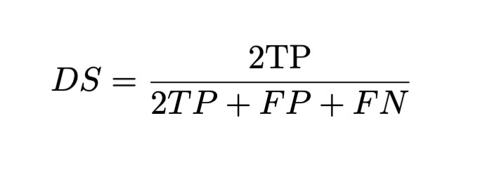
Dice Score
Characterize accuracy of Decision
[0,1]

Slide 27
Results
Now let’s go into details …

Slide 28
Conclusion
Now let’s go into details …

